Slide 1
DEF File (Design exchange format)
Presented by:
Chandu Raj SD

Slide 2
What is DEF File?
DEF file is used to represent the Physical layout of an Integrated Circuit (IC) in ASCII format.
Whenever we need to transfer the design database from one EDA tool to another EDA tool for further implementation or analysis, we use the DEF file to transfer the design data.

Slide 3
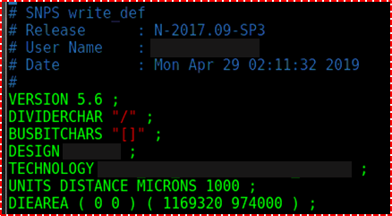
Content in DEF file
HEADER:-

Slide 4
Contents in DEF file
VERSION:- Specifies the version it will be 5.3 to 5.8
(default will be 5.6)
DIVIDERCHAR:- Specifies the character used to express hirarchy when DEF names are mapped to or from other database
BUSBITCHARS:- Specifies a pair of character used to specify busbit
DESIGN:- Specifies the name of the design
TECHNOLOGY:- Specifies a tech name for the design in the database

Slide 5
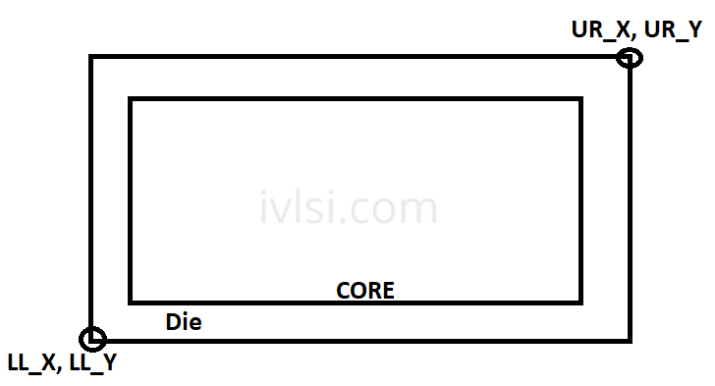
Contents in DEF file
DIE AREA:-
DIEAREA ( 0 0 ) ( 0 38 )
( 14 38 ) ( 14 22 )
( 18 22 ) ( 18 0 ) ;

Slide 6
DEF contents
IN FLOORPLAN | IN PLACEMENT
Version | Version
Divider char | Divider char
Busbit chars | Busbit chars
Design | Design
Units distance microns | Units distance microns
Diearea | Diearea
Components | Rows,vias
Pins | Components
Nets | Pins Special nets Nets Scan chains

Slide 7
.tf file (Technology file)

Slide 8
What is tf ?
tf file is called Technology file. . tf file basically contain the information of technology like metal layer, via , design rule information , colour of metals , pattern , linestyle
Tf file will be given by fabrication team

Slide 9
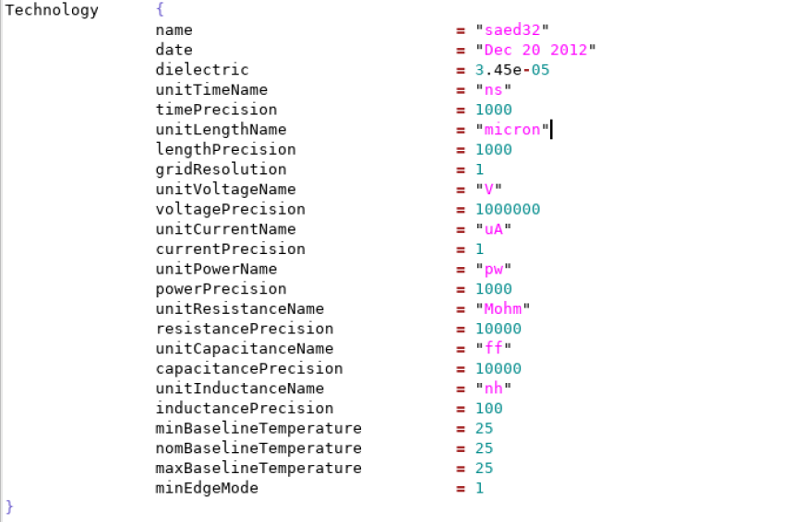
Content in tf file
Header:-

Slide 10
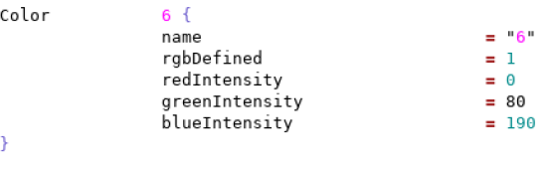
Content in tf file
Colour information:-

Slide 11
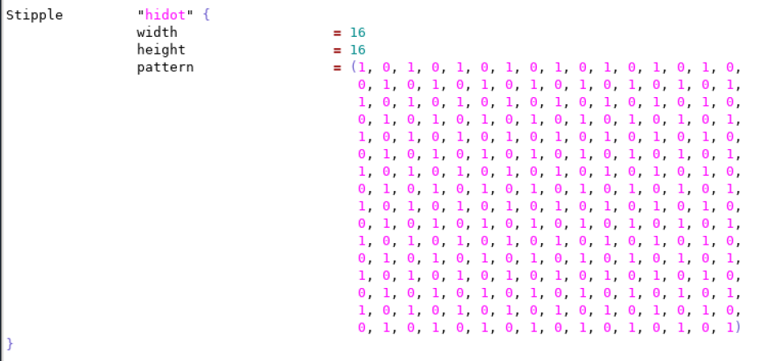
Content in tf file
Stipple :-

Slide 12
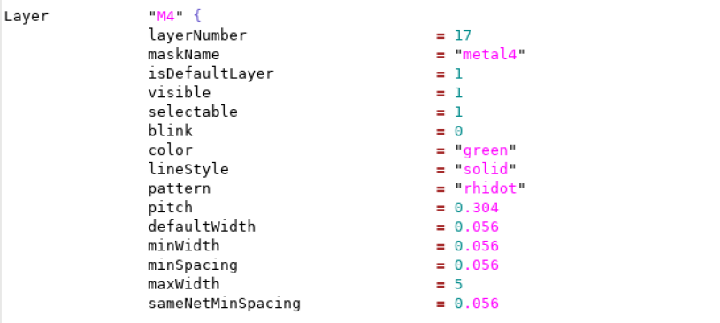
Content in tf file
Metal information:-

Slide 13
Thank you

